Slide 1
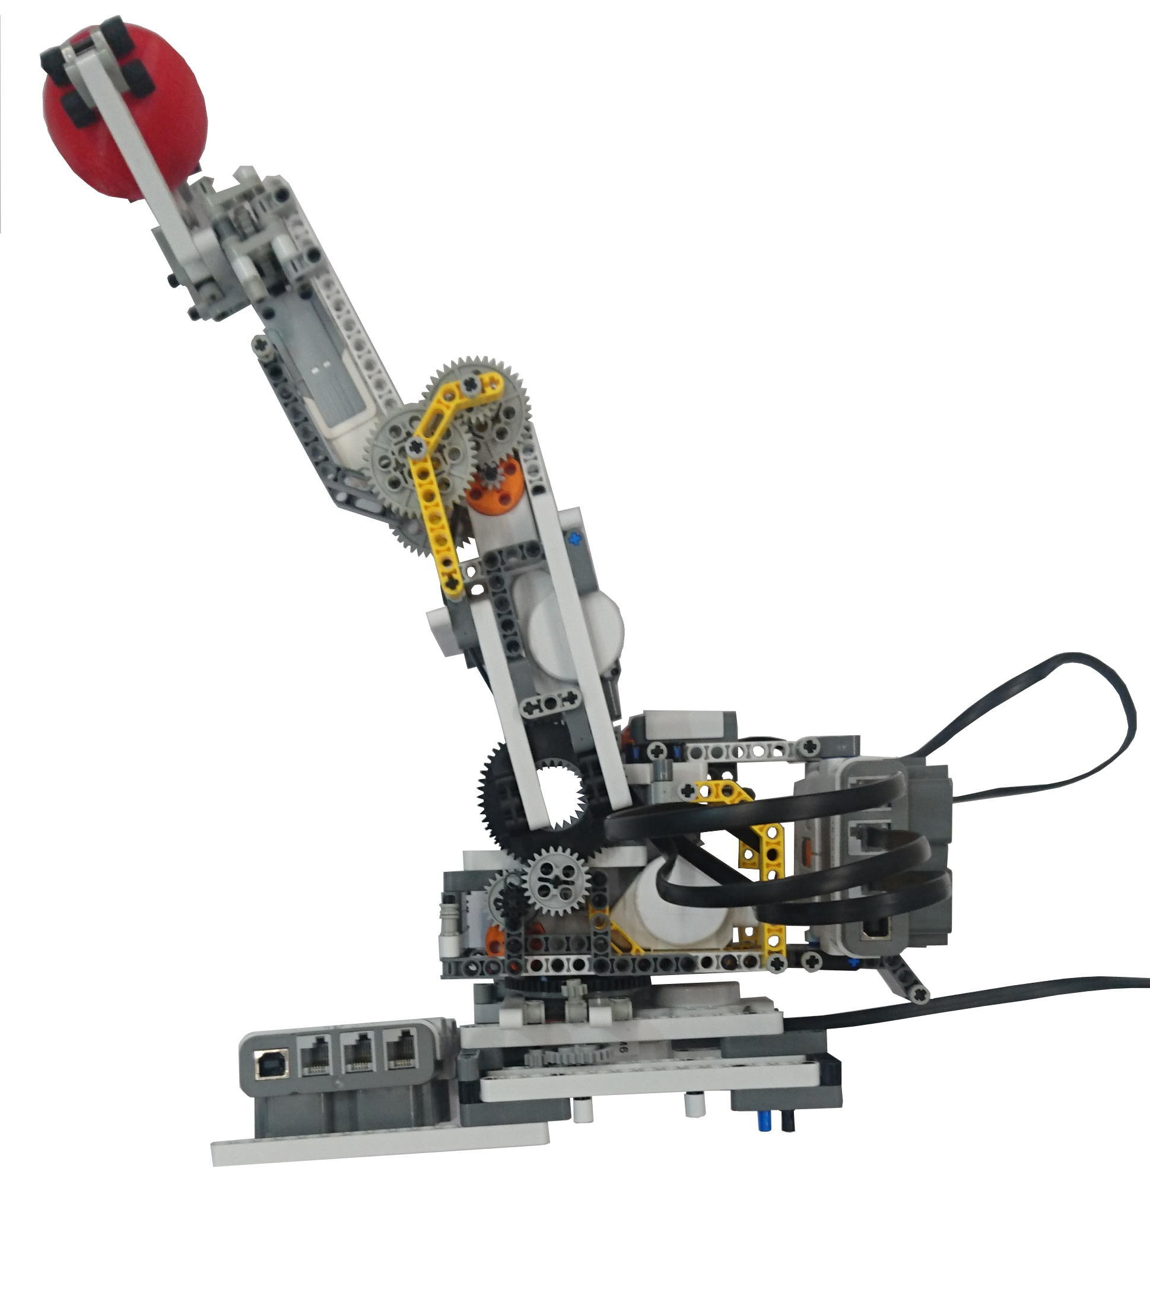
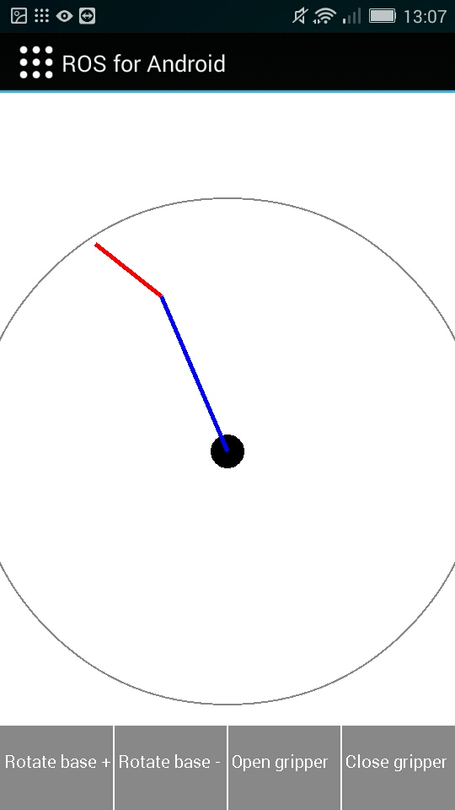
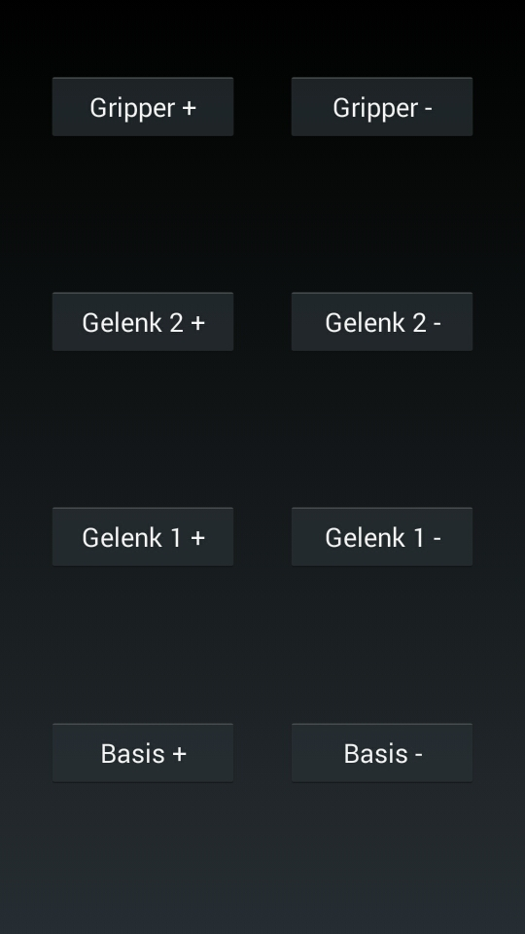


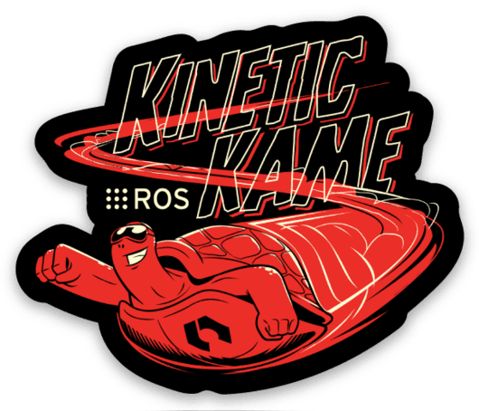
App-controlled LEGO robotic arm
Project of lecture „Mobile Computing“ (winter term 2018/2019)
Christoph Ulrich
Benjamin Schaefer
christoph.ulrich
benjamin.schaefer@htwg-konstanz.de
3 degrees of freedom
easily expandable (by means of extra sensors or similar)
can lift about 150g in the extended state (about 3/4 of its own weight)
Arm without base weighs about 200g
High repeatability of + - 1 degree (upper joint) or + - 0.5 degree (lower joint)
Regulation of the arm happens via a ROS actionserver
Joints and gripper individually controlled via buttons
Definition of the target pose via a tool center point
Calculation of the angles using reverse kinematics
Communication with the arm via ROS

